Slide 1

Internship Presentation on Automated Attendance Application
Tribhuvan University
Bachelor of Science in Computer Science and Information Technology (BSc. CSIT)
Texas College
Mitrapark, Kathmandu
Prepared By: Kunjung Sherpa
Roll Number: 2898/070

Slide 2

The environment you’re in shapes your thoughts, your actions and soon your future possibilities. Small cues from your environment that you receive on a daily basis over a long time changes you in so many ways you could hardly believe were true.
– Kunjung Sherpa
1

Slide 3
Overview
Introduction of the Company
Domain of the Company
Major Function of the Company
Internship Activities
Things Learnt from Internship
Snapshots
Conclusion
2

Slide 4
Ashleesha International
Located at Mulpani Chaur, Kathmandu, Nepal
Mentor: Mr. Prashant Dhungel (Project Manager)
Duration: Nov 09, 2017 – Feb 12, 2017
Timing: 11:00 A.M. – 5:00 P.M.
3

Slide 5




Domain of Jyaasa Technologies Pvt. Ltd.
AI for Decision Support
4

Slide 6
Major Function of the Company
AI for Decision Support (e.g: eye disease diagnosis)
Custom Software Development
Web Application Design and Development

Slide 7
Internship Activities
Build a Automated Attendance App
Learning Amazon Web Services
Build a Proof of Concept Web App using AWS
Research Face Recognition and use it in the Attendance App
Communicate Project Status with Project Manager
Working on a Team to build Attendance Version 2 (still in progress)
6

Slide 8
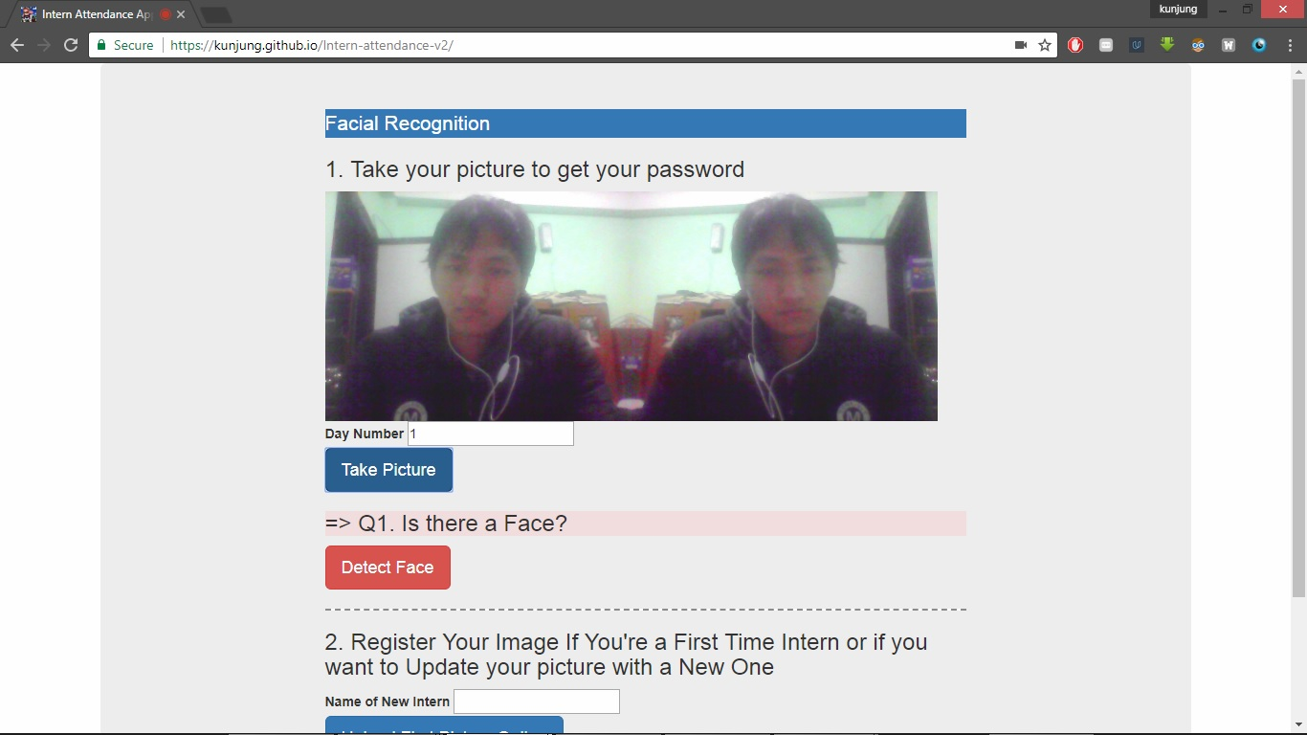
Building an Automated Attendance App

Slide 9
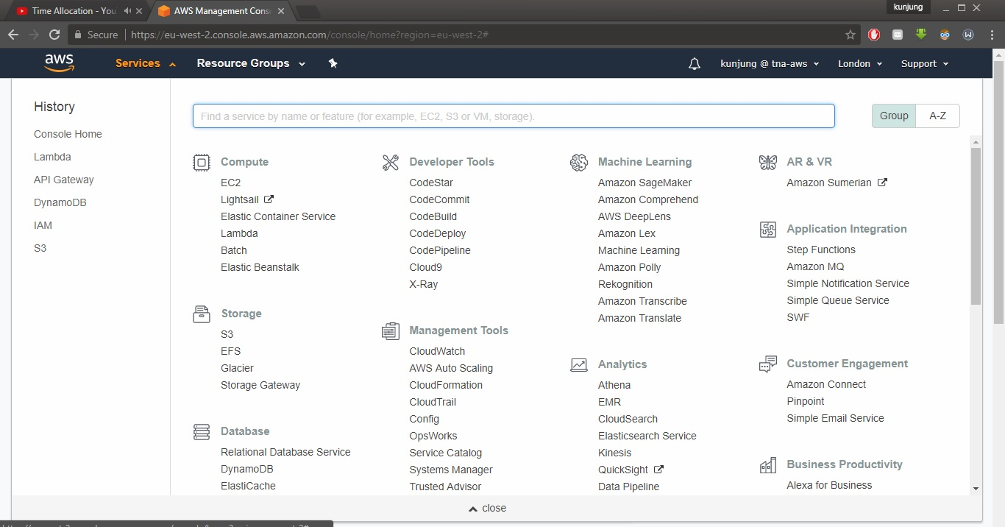
Learning Amazon Web Services

Slide 10
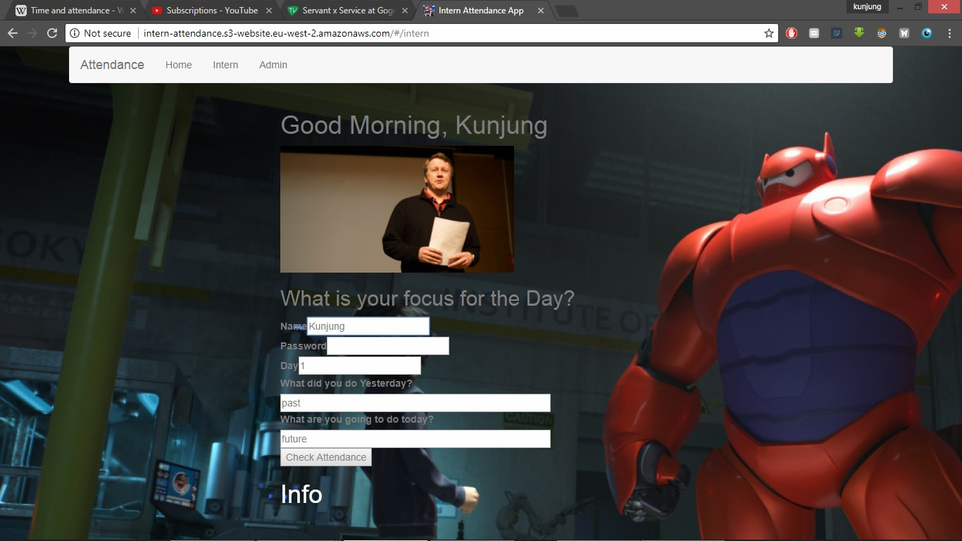
Build a Proof of Concept Web App using AWS

Slide 11
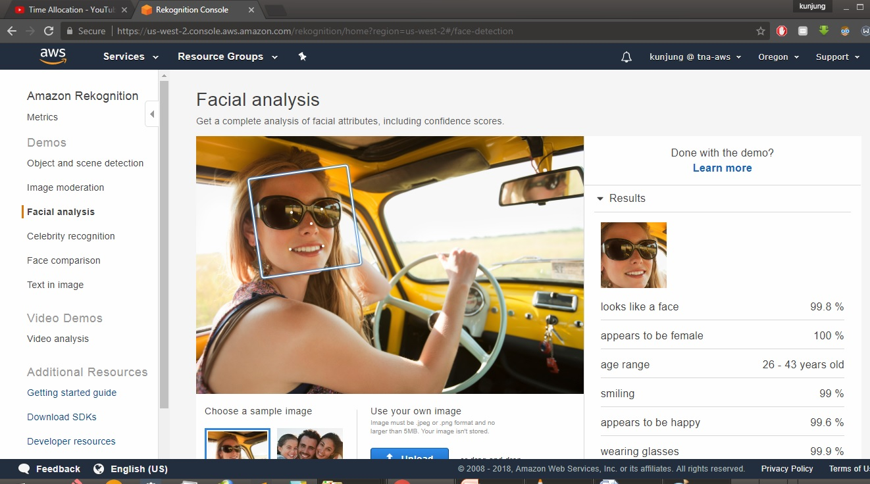
Research Face Recognition and use it in the Attendance App

Slide 12
Things Learnt in the Internship
Building web apps using AWS and Python
Problem Solving
Agile method using Trello boards and Slack
Communicating in a team
Time Management
Using time more productively

Slide 13
Conclusion
Real World is different from classroom Activity
Opportunity to Explore Field of Interest
Learn from Professionals
Develop few AWS Skills (lambda, s3, dynamodb, rekognition, api gateway, etc)
Develop Network Contacts

Slide 14
Thank You!
Any Questions?

